Slide 1
BUSINESS 115 – Economics, Markets and Law Week 8: Understanding Global Economic Linkages
Workshop: Exchange Rate Fluctuations and Net Exports

Slide 2
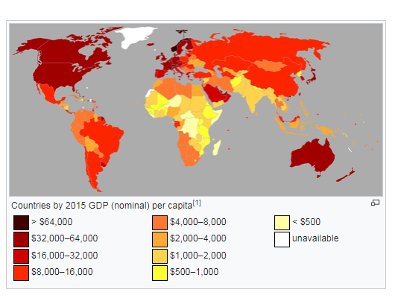
Why do we need to understand the global economy?
Are you planning on starting/running a business?
Where are the customers?
New Zealand is not big enough!
USA, Canada, Australia, Western Europe, Singapore…?
Countries with high per capita income?

Slide 3
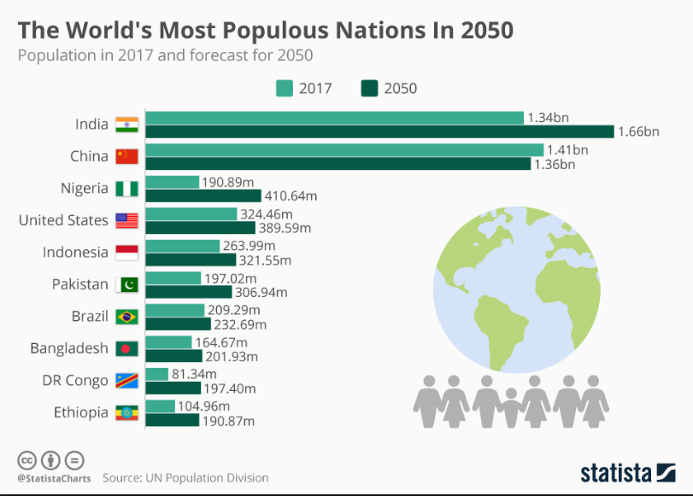
Why do we need to understand the global economy? 1. Where are the customers?
The population of advanced economies
Country | Population
USA | 322 million
Germany | 81 million
United Kingdom | 66 million
France | 65 million
Scandinavia | 25 million
(Sweden, Finland, Norway, Denmark)
Western Europe | 342 million
Australia | 25 million
New Zealand | 4.5 million
Singapore | 5 million

Slide 4
Why do we need to understand the global economy? 1. Where are the customers?
What proportion of China or India is “rich enough” (making US $32-$64K)?
Population approx. 1 billion!
1%? That is 10 million people…
5%? That is 50 million people
In 30 years’ time Nigeria will have 400 million people
If 10% are “rich enough”, that is 40 million people, nearly the size of Scandinavia and Australia COMBINED.

Slide 5
Why do we need to understand the global economy? 1. Where are the customers?
For most Kiwi businesses, even India is not on the radar;
forget Nigeria, Bangladesh, Indonesia or Congo
Indonesia has 264 million people (what percent are “rich enough”?)
Do you know what some “rich enough” African countries are?
Algeria: Per capita income $15,000. (Pop.=41 million; approx. 10 X NZ)
South Africa: Per capita income $13,403. (Pop.=56 million; approx. 12 X NZ)
Egypt: Per capita income $12,994. (Pop.=97 million; approx. 20 X NZ)
Tunisia: Per capita income $11,987.(Pop.=12 million; approx. 3 X NZ)

Slide 6
Why do we need to understand the global economy? 1. Where are the customers?
In 2012, India opened up its retail market to foreign investors.
According to a 2007 report by McKinsey, in 2005 India’s middle class accounted for only 5% of its population.
But this figure is slated to grow to 20% in 2015 and to 40% by 2025.
India has a population of more than 1 billion!
20% of 1 billion is 200 million; that is the size of roughly three-quarters of the United States, about eight Australias and fifty New Zealands!
India is literally two different countries: a very “poor” country of (say) 800 million but another “rich” country of (say) 200 million with incomes comparable to citizens of the “first world”.

Slide 7
Today’s Plan
Learning Activity A: Nominal Exchange Rate
How to determine the exchange rate?
Discussion: An increase in foreign interest rates
Discussion: Currency Manipulation
Learning Activity B: Real Exchange Rate
Workshop Quiz

Slide 8
A. Nominal Exchange Rate Trade and International Prices
International trade and investment are influenced by changes in international prices.
The two most important international prices are the nominal exchange rate and the real exchange rate.
By watching webcast 8.2, you have learned the concepts and the tools related to these prices.
In the following, we will use these tools to analyse some scenarios.

Slide 9
A. Nominal Exchange Rate 1. How to determine the exchange rate?
Suppose you buy one British pound (GBP) with two NZ dollar (NZD) at ANZ bank. Let us define the nominal exchange rate as One NZD trades for 1/2 GBP, e = ½
If one NZ dollar buys more (less) foreign currency, there is a nominal appreciation (depreciation) of the dollar, as shown by a rise (fall) in e.
Demand curve for the dollar shows how many units of the currency individuals would like to hold at various exchange rates. It is downward sloping.
Supply curve for the dollar shows how many units of the currency deposits are available for individuals to hold at various exchange rates. It is upward sloping.

Slide 10
A. Nominal Exchange Rate 1. How to determine the exchange rate?
e=£/$
Supply
Demand
4
2
1/2
Quantity of dollars

Slide 11
A. Nominal Exchange Rate 1. How to determine the exchange rate?
e=£/$
Supply
Demand
e2
Surplus of dollars;
Dollar depreciates
e1
Shortage of dollars;
dollar appreciates
e3
Quantity of dollars

Slide 12
Discussion: What if the interest rate on GBP-denominated deposits rise?
How do investors respond to the rise in foreign interest rates?
How does the investors’ decision affect the two curves?
How does the exchange rate move?
e=£/$
Supply
e1
Demand
Quantity of dollars

Slide 13
Discussion: What if the interest rate on GBP-denominated deposits rise?
If the foreign interest rate rises, investors
sell dollar-denominated assets,
exchange dollars for British pounds,
make GBP denominated deposits.
e=£/$
Supply
Dollar
depreciates
in value
e1
As a result, the supply curve for the dollar shifts rightward.
e2
Demand
Quantity of dollars

Slide 14
Discussion: Currency Manipulation
RNBZ “controls” the money supply (NZ dollars) in NZ.
If RBNZ sells NZ dollar and buy GBP-denominated assets, the supply curve of the dollar shifts rightwards.
e=£/$
Supply
Dollar
depreciates
in value
e1
This exercise shows the mechanism of Currency Manipulation by central banks.
e2
Demand
Quantity of dollars
BBC News: US labels Switzerland a currency manipulator

Slide 15
Today’s Plan
Learning Activity A: Nominal exchange rate
Learning Activity B: Real Exchange Rate
Why do we need real exchange rates?
Big Mac Index vs. Mini Mac Index
Purchasing power parity and currency under/over-valuation
Workshop Quiz

Slide 16
B. Real Exchange Rate 1. Why do we need real exchange rates?
It is quite common to hear people claim that a country’s nominal exchange rate is overvalued or undervalued.
The first question one should ask when someone claims the exchange rate is overvalued is “overvalued/undervalued with respect to what?”
Concepts of purchasing power parity (PPP) and real exchange rates.

Slide 17
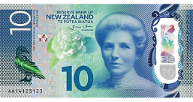
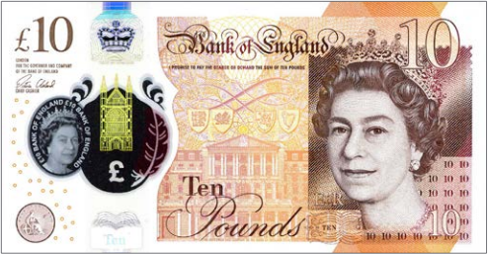
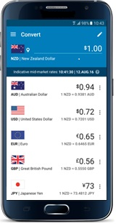
B. Real Exchange Rate 1. Why do we need the real exchange rate?
In order to understand the concept of purchasing power parity, we need to first introduce the concept of the real exchange rate.
nominal exchange rate
real exchange rate
vs.
vs.
In NZ
In UK
the actual price in the foreign exchange market (check it in your phone)
artificially created by economists
$$\text{Real} \text{Exchange} \text{Rate}=\frac{\text{e} \text{∗ }\text{Domestic} \text{Price}}{\text{Foreign} \text{Price}}$$
e $=$ Number of pounds per dollar

Slide 18
Exercises: Big Mac Index
Suppose the nominal exchange rate is $2 = £1
How much is the e defined on the last page?
Suppose a Big Mac costs $4 in Auckland and £2 in London
How many Big Macs can you buy in Auckland with NZ$100?
How many British pounds can you exchange with NZ$ 100?
How many Big Macs can you buy in London with the amount GBP exchanged just now?
How much is the real exchange rate as defined on the last page?

Slide 19
Exercises: Big Mac Index
Suppose the nominal exchange rate is $2 = £1
How much is the e defined on the last page?
Suppose a Big Mac costs $4 in Auckland and £2 in London
How many Big Macs can you buy in Auckland with NZ$100?
How many British pounds can you exchange with NZ$ 100?
How many Big Macs can you buy in London with the amount GBP exchanged just now?
How much is the real exchange rate as defined on the last page?
e = Number of pounds per dollar = 0.5
$$\frac{\text{100}}{\text{4}}=25$$
NZ$100*0.5 = £ 50
$$\frac{\text{5}\text{0}}{\text{2}}=25$$
$$\frac{\text{e} \text{∗ }\text{Domestic} \text{Price}}{\text{Foreign} \text{Price}}=\frac{\text{0.5} \text{∗ }\text{4}}{\text{2}}=1$$
=> 1 NZ Big Mac is equivalent to 1 British Big Mac

Slide 20
B. Real Exchange Rate 2. Purchasing Power Parity
The theory of purchasing-power parity (PPP) is the simplest and most widely accepted theory measuring the under/overvaluation of currencies.
According to the PPP theory, a unit of any given currency should be able to buy the same quantity of goods in all countries.
If the PPP indeed holds, what is the value of the real exchange rate?
$\text{Real} \text{Exchange} \text{Rate}=\frac{\text{e} \text{∗ }\text{Domestic} \text{Price}}{\text{Foreign} \text{Price}}$
20

Slide 21
B. Real Exchange Rate 2. Purchasing Power Parity
If the purchasing power of the dollar is always the same at home and abroad, the real exchange rate does not change.
The nominal exchange rate ($\text{e}$) between the currencies of two countries must reflect the different price levels in those countries.
21

Slide 22
B. Real Exchange Rate 2. Purchasing Power Parity
What lies behind the PPP theory?
The Law of One Price (LOOP): a good must sell for the same price in all places.
What lies behind the LOOP?
If the same good is sold at the different prices in different locations (countries), people will buy low and sell high (arbitrage) for profit. Eventually, prices in two markets would converge.
According to the PPP theory, a currency must have the same purchasing power in all countries and exchange rates move to ensure that.
22

Slide 23
B. Real Exchange Rate 2. Purchasing Power Parity
Limitations of the PPP Theory
Many goods are not easily traded or shipped from one country to another.
Tradable goods are not always perfect substitutes when they are produced in different countries.
23

Slide 24
Discussion: Currency Depreciation and Net Exports
A depreciation in the NZ real exchange rate means that NZ goods have become cheaper relative to foreign goods.
How does the depreciation of NZ dollar affect the foreign demand for NZ goods/services? (Hint: use the definition of real exchange rate to show how a nominal depreciation can affect the real exchange rate.)
How does the depreciation of NZ dollar affect the domestic demand for foreign goods/services?
How does it affect net exports (NX = Exports – imports) of New Zealand?

Slide 25
Discussion: Currency Depreciation and Net Exports
As shown before, $\text{Real} \text{Exchange} \text{Rate}=\frac{\text{e} \text{∗ }\text{Domestic} \text{Price}}{\text{Foreign} \text{Price}}$
In the short run, domestic and foreign prices do not change.
The fall in $\text{e}$makes NZ products cheaper in the world markets, real depreciation, while it makes foreign products more expensive in NZ.
Thus, consumers both at home and abroad buy more NZ goods (NZ exports more) and fewer goods from other countries (NZ imports less). Thus, NZ exports rise, and NZ imports fall, and both of these changes raise NZ net exports (NX = Exports – imports)

Slide 26
Socrative.com
Chaudhuri251

Slide 27
Question #1
If the exchange rate changes from 35 Thai Baht per dollar to 40 Thai Baht per NZ dollar, then the dollar has:
Appreciated and buys more Thai goods.

Slide 28
Question #1
e=Thai Baht/NZ $
If exchange rate increases, dollar
appreciates. Why?
Increase in demand for dollars?
Supply
e1
If exchange rate decreases, dollar
Depreciates. Why? Increase in
Supply of dollars?
Demand
Quantity of dollars

Slide 29
Question #2
The real exchange rate is the:
rate at which domestic goods are traded for foreign goods.
Nominal exchange rate is the rate at which currencies can be exchanged. Real exchange rate is goods for goods…and provides a measure of how relatively expensive/inexpensive things are and the purchasing power of money

Slide 30
Question #3
If the NZ dollar appreciates with regards to the US dollar:
Suppose exchange rate changes from 1 US dollar/1 NZ Dollar to 2 US dollar/1 NZ dollar.
This means NZ goods become more expensive in US dollars.
US goods become less expensive in NZ dollars;
NZ imports will rise and exports will fall.

Slide 31
Question #4
If purchasing-power parity holds, then the value of the:
real exchange rate is equal to one.

Slide 32
Question #5
Suppose that a ton of coal costs 840 British pounds in the UK and $1400 in the United States. Further suppose that the nominal exchange rate is 0.6 pounds per dollar, then real exchange rate for coal can be expressed as:
840 pounds
1400 US dollars
1 ton of coal in UK
1 ton of coal in US
So real exchange rate of 1; 1 ton of UK coal for 1 ton of US coal

Slide 33
Question #5
Suppose that a ton of coal costs 840 British pounds in the UK and $1400 in the United States. Further suppose that the nominal exchange rate is 0.6 pounds per dollar, then real exchange rate for coal can be expressed as:
$$\text{Real} \text{Exchange} \text{Rate}=\frac{\text{e} \text{∗ }\text{Domestic} \text{Price}}{\text{Foreign} \text{Price}}$$
Real Exchange Rate in USA = (0.6)*[(1400)/(840)] = 1

Slide 34
Question #6
Suppose an iPad costs $800 in New Zealand and 30,000 Indian Rupees in India. The current exchange rate is 50 Indian rupees per NZ dollar. For the sake of convenience we will assume that taxes and transportation costs come to $50 per iPad. Which of the following statements is correct?
Buy Ipads in India for 30,000 which is equivalent to 600 NZ dollars.
Pay $50 each for shipping for a total of $650.
Sell for $800 to make a profit of $150 per Ipad.

Slide 35
Question #7
Suppose an iPad costs $800 in New Zealand and 20,000 Yuan in China. If we define the exchange rate as number of Chinese Yuan per NZ dollar, then which of the following nominal exchange rates will imply purchasing power parity (i.e., a real exchange rate of 1 Ipad in China for 1 Ipad in NZ)?
For real exchange rate to be 1 (i.e 1 NZ Ipad equivalent to 1 Chinese Ipad)
The nominal exchange rate must be such that 800 NZ dollars must convert to 20,000 Yuan.
This will happen when 1 NZ dollar = (20,000/800) = 25 Yuan.

Slide 36
Question #8
Suppose the equilibrium exchange rate between the NZ dollar and British pound is initially 2 NZ dollars to the pound. Suppose the NZ government decides that it is going to actively intervene in this market so as to hold the value of the NZ dollar at a value of 3 NZ dollars to the pound. In the currency market for NZ dollars:
This implies that the value of the NZ dollar falls from ½ pound to 1/3 pound
If exchange rate is number of pounds per 1 NZ dollar then this has just gone down from ½ to 1/3.
NZ dollar depreciates.

Slide 37
Question #8
e= Pounds/NZ $
If exchange rate decreases, dollar
Depreciates. Increase in
Supply of dollars.
Supply
1/2
1/3
Demand
Quantity of dollars

Slide 38
Question #8
Suppose foreign investors anticipate that real interest rates in NZ will start to rise soon and financial assets in NZ will yield a higher return than in other countries. As a result of this you would anticipate that there will be:
Greater financial investments in NZ.
Increased demand for NZ dollars.
Appreciation in the value of the dollar.

Slide 39
Question #9
If investors demand more NZ
dollars then demand for dollars
Increases. This leads to an increase
in the exchange rate and
an appreciation of the dollar
Supply
e1
Demand
Quantity of dollars

Slide 40
Question #10
If the NZ dollar appreciates in value vis-à-vis the US dollar then:
NZ importers of US goods are better off since US goods are now relatively cheaper.

Slide 41
Learning Outcomes
Upon successful completion of this week’s module, you should be able to:
distinguish nominal and real exchange rates,
explain the exchange rate determination in the currency market;
use the purchasing power parity to determine currency undervaluation or overvaluation;
explain the mechanism of currency manipulation and its impacts on net exports.

Slide 42
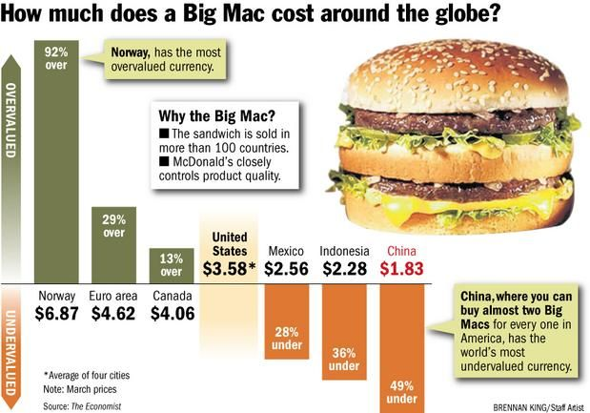
Big Mac Index
Twice a year, the Economist Magazine sends out people to purchase Big Macs all over the world.
After they’ve eaten, they then convert the price they paid into dollars, and the index can show whether a currency is under or overvalued when compared to the US dollar.
Basically, the less you pay for a Big Mac in a country after it’s been converted into dollars, the more that currency is undervalued.

Slide 43
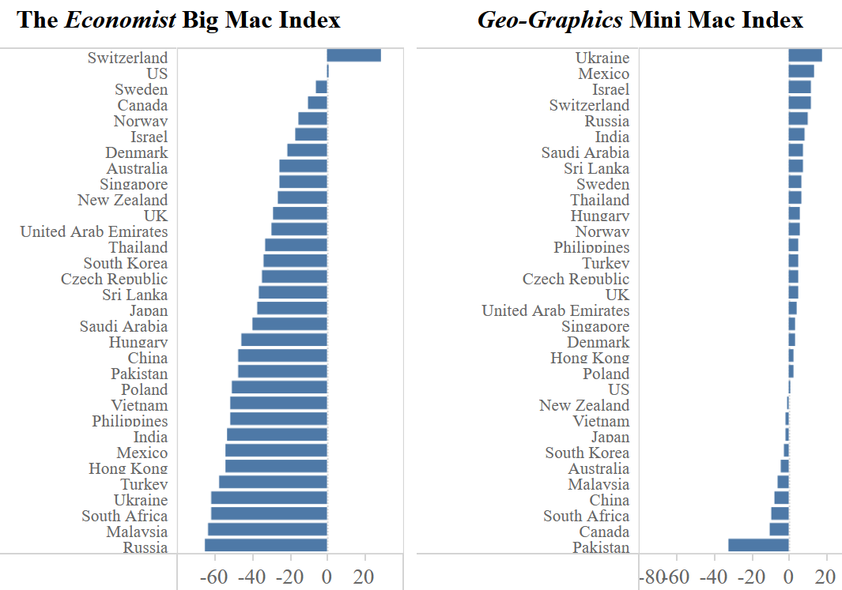
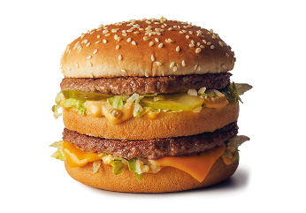
Discussion:
Why do the two indices give very different predictions for NZ dollar?
According to the Big Mac Index, NZ dollar was undervalued by 26.3% in 2019.
According to the Mini Mac Index, NZ dollar was undervalued only by 1.4% in 2019.
Source: https://www.cfr.org/blog/mini-mac-shows-chinas-currency-shifting-undervaluation
Currency Under(-)/Over(+) valuation against the US dollar (%)

Slide 44
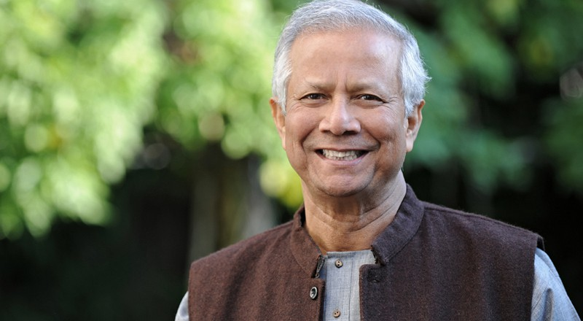
Why do we need to understand the global economy? 2. The Case Study on Shakti Doi
Recent reports suggest that over the last few years, the price of milk and milk products (a key export item for NZ) in India rose by 15.3%; driven by increased demand from a growing middle-class.
In 2005 the CEO of Groupe Danone in France (Dannon in the USA) met with Muhammad Yunus, the founder of Grameen Bank, a well-known microfinance organization.
This eventually led to the establishment of Grameen Danone, a “social (non-profit) business” that produces Shakti Doi (or “Strong Yoghurt”).
Muhammad Yunus Nobel Peace Prize (2006)

Slide 45
Why do we need to understand the global economy? 2. The Case Study on Shakti Doi
While selling yoghurt to the poor at no profit may not seem like a winning strategy, it helped Danone learn valuable lessons in terms of product development, factory design and how to make inroads into new markets.
Danone has figured out how “to put enough vitamin A, iron, zinc and iodine into a 60 g or 80 g cup of yogurt to meet 30% of a child's daily needs….”
Now Danone is using that knowledge in products for the developed world, where the company sells fortified yogurt targeting things like bone strength in older adults.

Slide 46
Why do we need to understand the global economy? 2. The Case Study on Shakti Doi
Danone also figured out how to keep milk fresh for a longer time by using enzymes since refrigeration is often not available.
This attempt by Danone has provided a template for how the company may push deeper into Asia and Africa, the two biggest growth areas.
While Danone may not make money out of its social business, the value of its name recognition is immense; and surpasses what could have been accomplished via advertising.

Slide 47
Why do we need to understand the global economy? 2. The Case Study on Shakti Doi
Danone already has a presence in India through its Yakult brand of probiotic milk drink. This is a joint venture with Yakult Honsha, Japan.
But given the size of the market it is likely that there is scope for other players.
It is also an option to simultaneously enter into profitable joint ventures in the urban areas while setting up social non-profit undertaking in rural areas in order to get market penetration.

